Slide 1
A Warm Welcome To Careerera Family

Slide 2

WHAT IS TABLEAU
Tableau is a powerful and fastest growing data visualization tool used in the Business Intelligence Industry.
Tableau helps create the data that can be easily understood by professionals .
With Tableau tool the analysis of data is very fast and the visualizations created are in the form of dashboards and worksheets.

Slide 3
ABOUT TABLEAU
1. The great thing about Tableau software is that it doesn't require any technical or any kind of programming skills to operate.
2. It is very fast to deploy, easy to learn and thus becomes very intuitive to use for a customer.
3. The best features of Tableau software are
Data Blending
Real time analysis
Collaboration of data

Slide 4
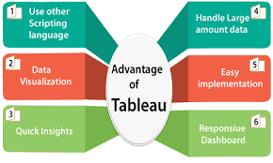
ADVANTAGES OF TABLEAU

Slide 5
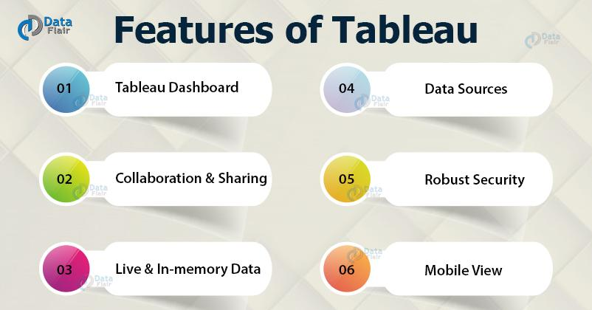
FEATURES AND USES OF TABLEAU

Slide 6
INTRODUCTION TO DATA VISUALIZATION
Data visualization is the graphical representation of information and data. By using visual elements like charts, graphs, and maps.
Data visualization tools provide an accessible way to see and understand trends, outliers, and patterns in data.
The main goal of data visualization is to make it easier to identify patterns, trends and outliers in large data sets.
Visualization is important because it helps to prepare and to teach you how to respond to a situation before it happens. I

Slide 7
RULES OF DATA VISUALIZATION
Begin with a goal
Starting with a goal provides the foundation to bring together all the important tools of data visualization and express it in a effective and meaningful way.
2. Know your data
knowing the context behind data is as important as understanding the data itself. This knowledge will also serve to verify that you have the best data to support your goal.

Slide 8
RULES OF DATA VISUALIZATION
3. Put your audience first
Data visualization is rarely one size fits . Know about your audience preference and focus on visualizing what they need.
4. Keep it simple
This is the golden rule. Always choose the simplest way to convey. You must identify the patterns and focus on what you want to show, design to the point and make sure every element serves a purpose.

Slide 9
RULES OF DATA VISUALIZATION
5.keep it precise
The most important component of data visualisation is the data itself. Use an effective charts to represents your data ,and know the limits of chart and what key features of data they best visualize. So that you can draw your audience attention.
6.Design to the point
Over-designing may lead important information complex and harder to find and remember as well. Removes all unnecessary headers or labels ,keep it simple and meaningful.

Slide 10
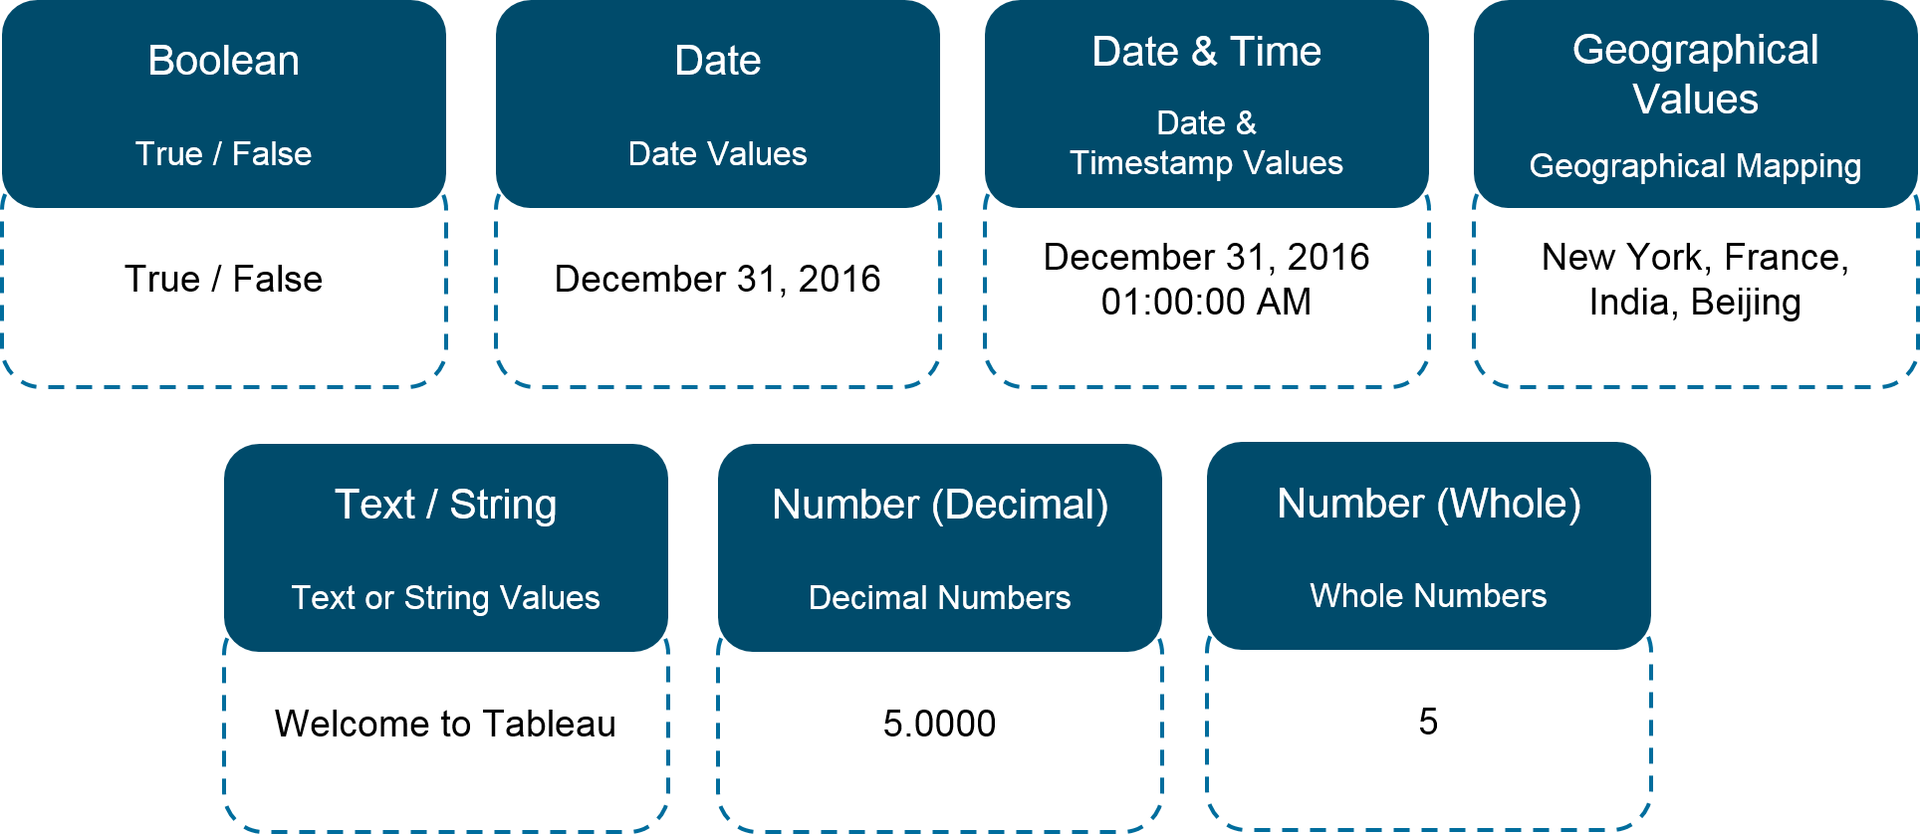
TABLEAU DATATYPES

Slide 11
DATA SOURCES IN TABLEAU
Tableau can connect to almost all data sources which are widely used in Business Intelligence.
For Example:
File Systems such as CSV, Excel, etc.
Relational Systems such as Oracle, Sql Server, DB2, etc.
The most basic operation we need to learn is to connect to a data source.
Once we establish a secure connection with various types of data sources ,we can access the data for analysis.

Slide 12
CONNECTIONS
There are two types of data sources that you can connect to in Tableau:
a) Connecting to a File
Tableau offers its user’s with a wide variety of options to connect and get data from a file in your system.
The connection that tableau provide to it’s users are MS Excel, MS Access, JSON, text file, PDF file, spatial file, etc.
Further with the help of the More option, you can access the data files from your own system and connect them with Tableau.

Slide 13
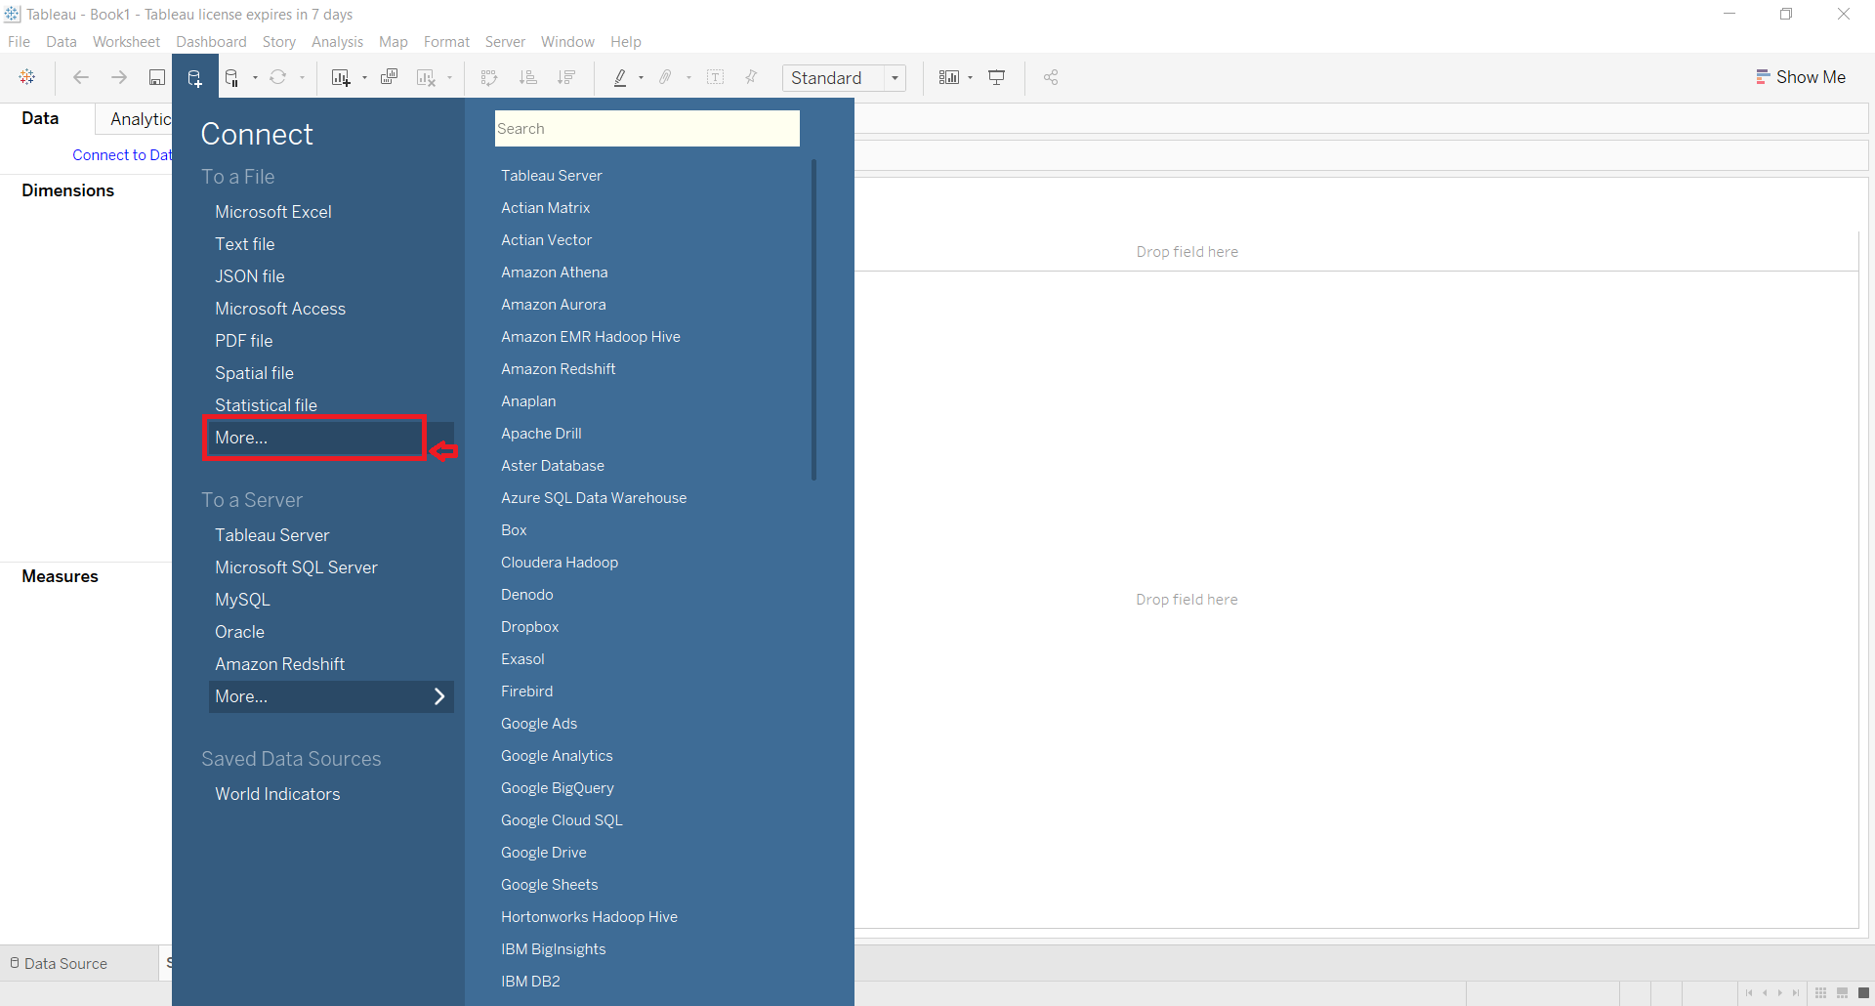
PICTORIAL REPRESENTATION OF TABLEAU SHOWING THE MORE BUTTON

Slide 14
CONNECTIONS
b) Connecting to a Server
The connection to a server has countless options for an online data source to connect with, few of them are mention below:
Server-based Relational Database: Tableau Server, Microsoft SQL Server, Oracle, MySQL, IBM DB, Mongo DB etc.
Cloud-based Data Sources: Cloudera Hadoop, Google Cloud SQL, Amazon Aurora, etc.
Web-based Data Sources: Web Data Connector
Big Data Sources: Google Big Query

Slide 15
CONNECT TO A SERVER
When you connect to such data sources, you need to give some basic information such as :
a. server name
b. user name
c. password specific to that connection
In the Connect pane of Tableau, You can click on More option to explore and use all the available server-based data sources.

Slide 16
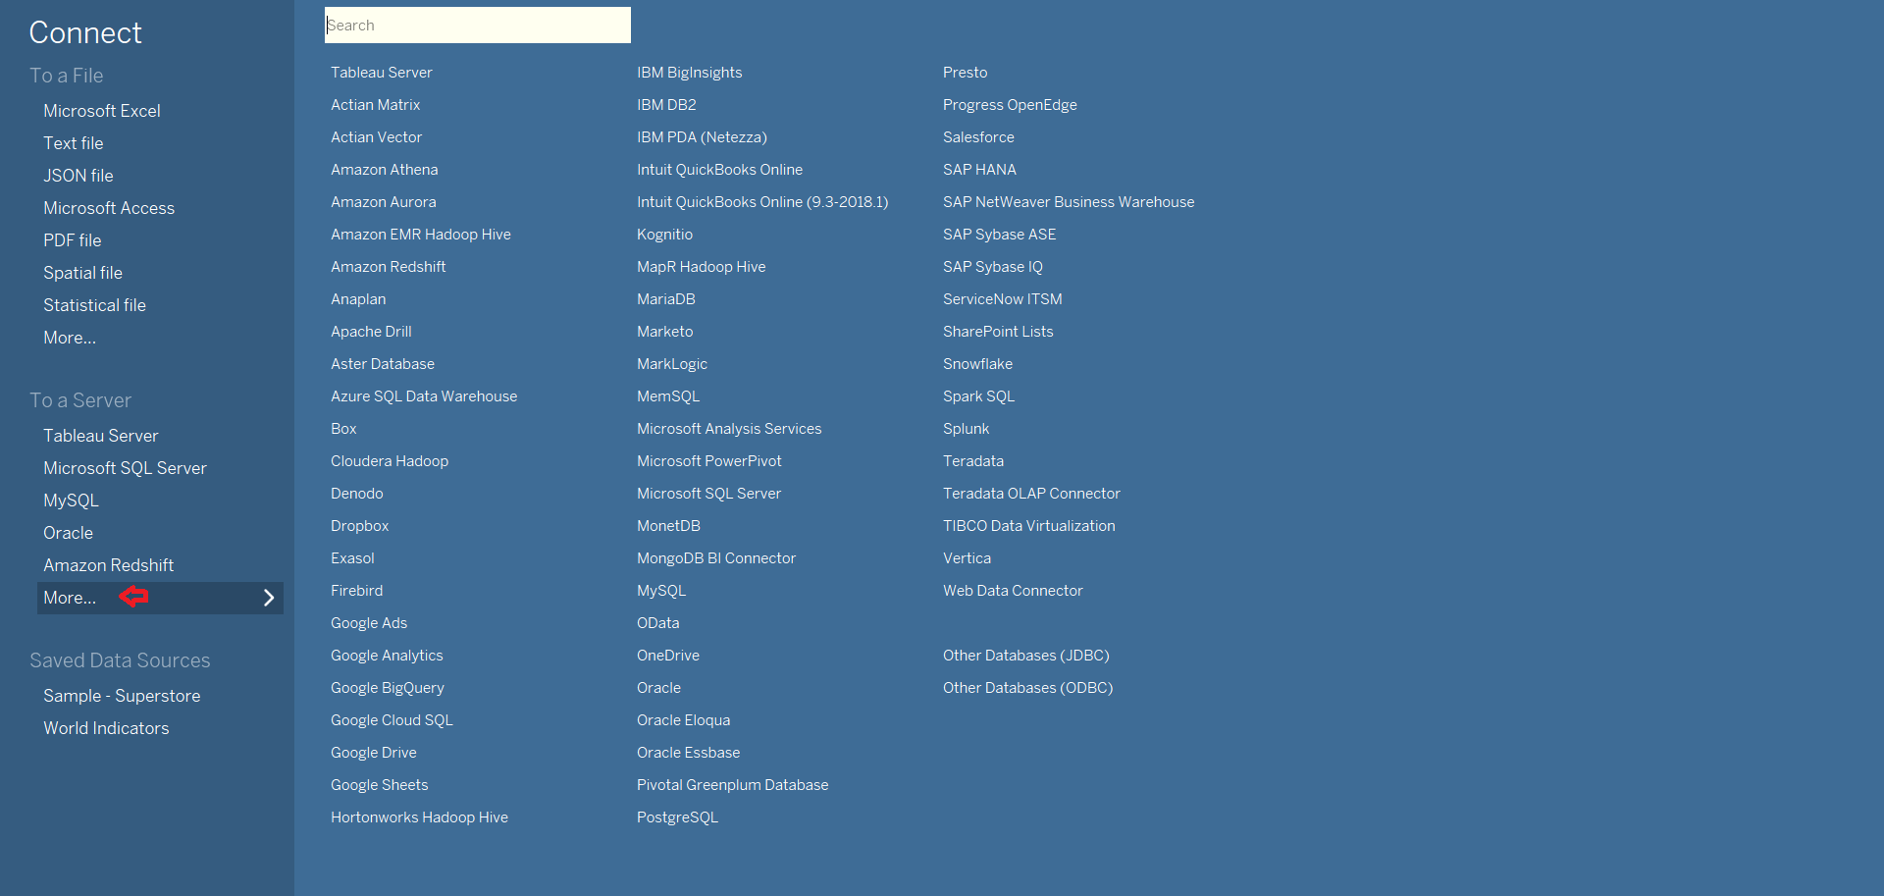
PICTORIAL REPRESENTATION OF TABLEAU SHOWING THE MORE BUTTON

Slide 17
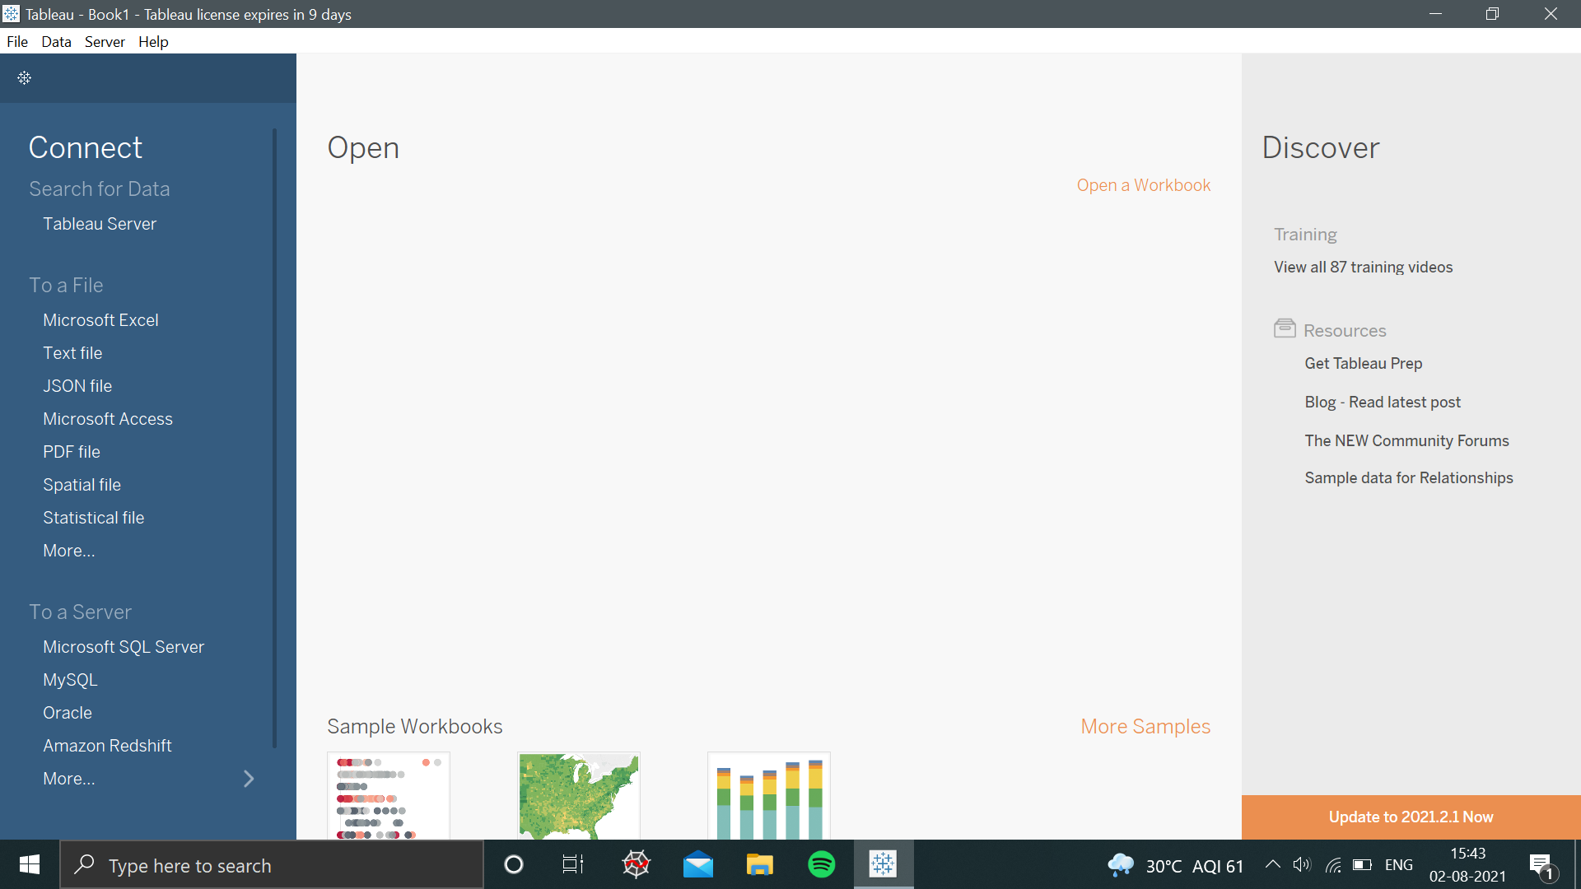
LOADING FILE IN TABLEAU
Tableau Interface:

Slide 18
STEPS TO IMPORT MICROSOFT EXCEL FILE INTO TABLEAU
Step 1: To import data from an excel file, first, you need to click on "Microsoft Excel" under the connect tab as shown in the picture above.
Step 2: Then a dialog box will be prompted ,where you can navigate to the Excel file in your system from which you want to import the data.
Step 3: Then, click on the file and click on ‘Open’ button.
Note: Also remember that if any data is updated in the source file, you need to refreshed the connection each time the data is modified to keep the data up-to-date in Tableau.

Slide 19
DATA AGGREGATION IN TABLEAU
Data aggregation is the process where data is collected and presented in a summarized format for statistical analysis and to effectively achieve business objectives.
Aggregate Functions are a type of function where values of multiple rows are grouped together as the input to form a single value .
Every measure has a default aggregation which is set by Tableau when you connect to a data source.

Slide 20
CONTINUOUS DATA
Continuous data is data that can take any value sequentially within a finite or infinite range of possible value.
Continuous data is measurable.
continuous fields draw axes
continuous fields cannot be sorted
In Tableau green indicates that a field is continuous.
The continuous data can be broken down into fractions and decimal, i.e. it can be further subdivided into smaller parts .

Slide 21
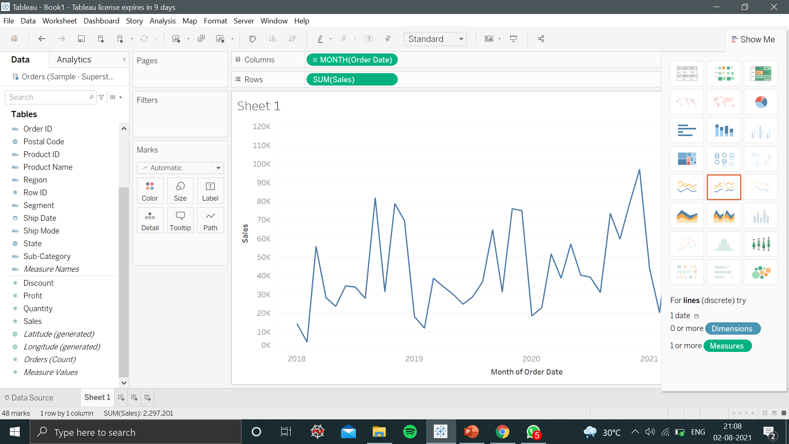
WORKING WITH CONTINUOUS DATA IN TABLEAU

Slide 22
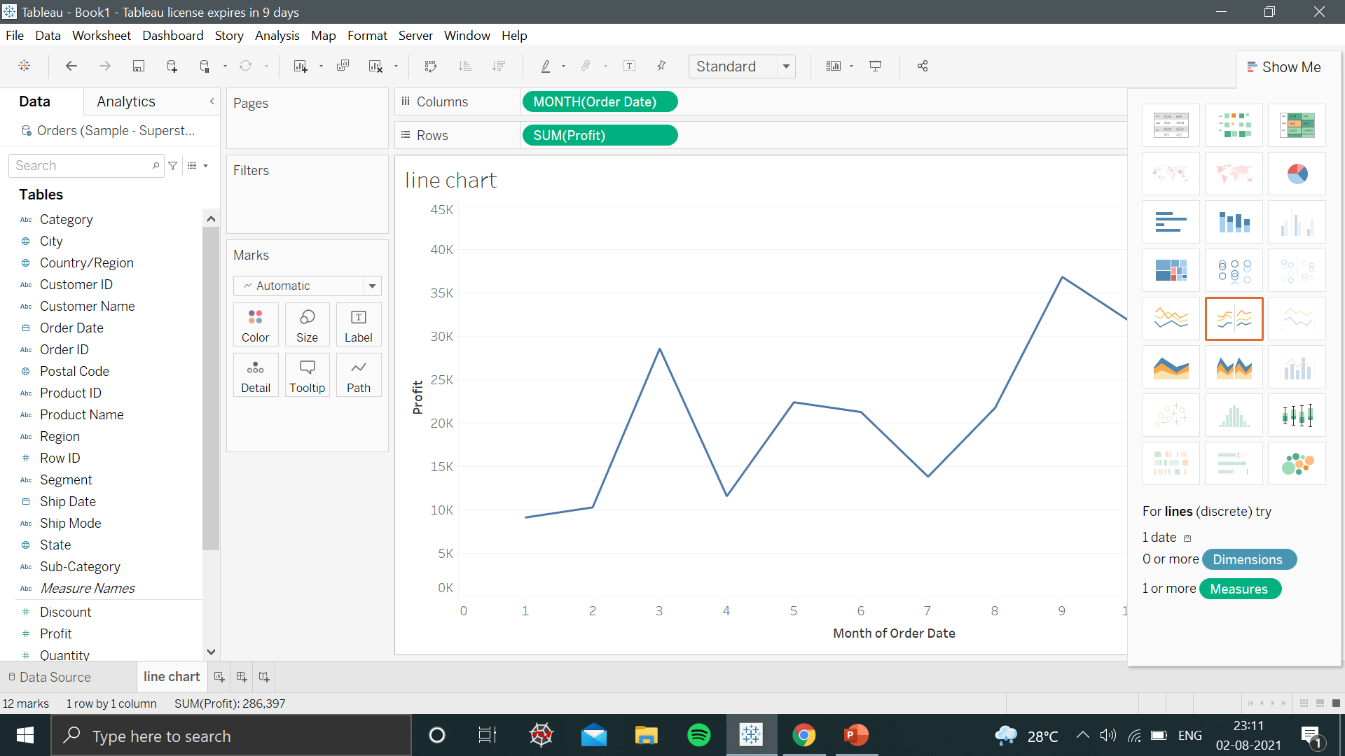
PROFIT BY MONTH

Slide 23
DISCRETE DATA
The term discrete implies distinct or separate.
So, discrete data refers to the type of quantitative data that can be counted.
Discrete fields draw headers.
Discrete fields can be sorted
In tableau Blue indicates that a field is discrete
It contains only finite values, which cannot be further broken down into fraction or decimal’s ,or you can say that whose subdivision is not possible.

Slide 24
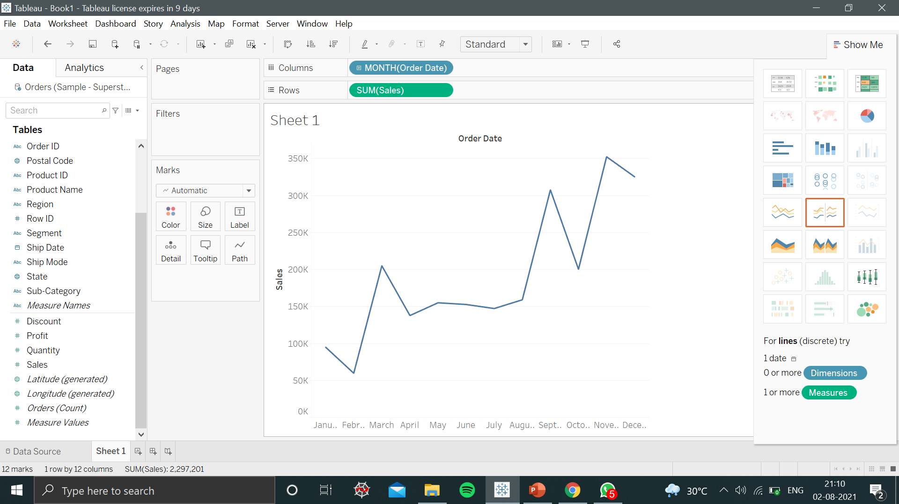
WORKING WITH DISCRETE DATA IN TABLEAU

Slide 25
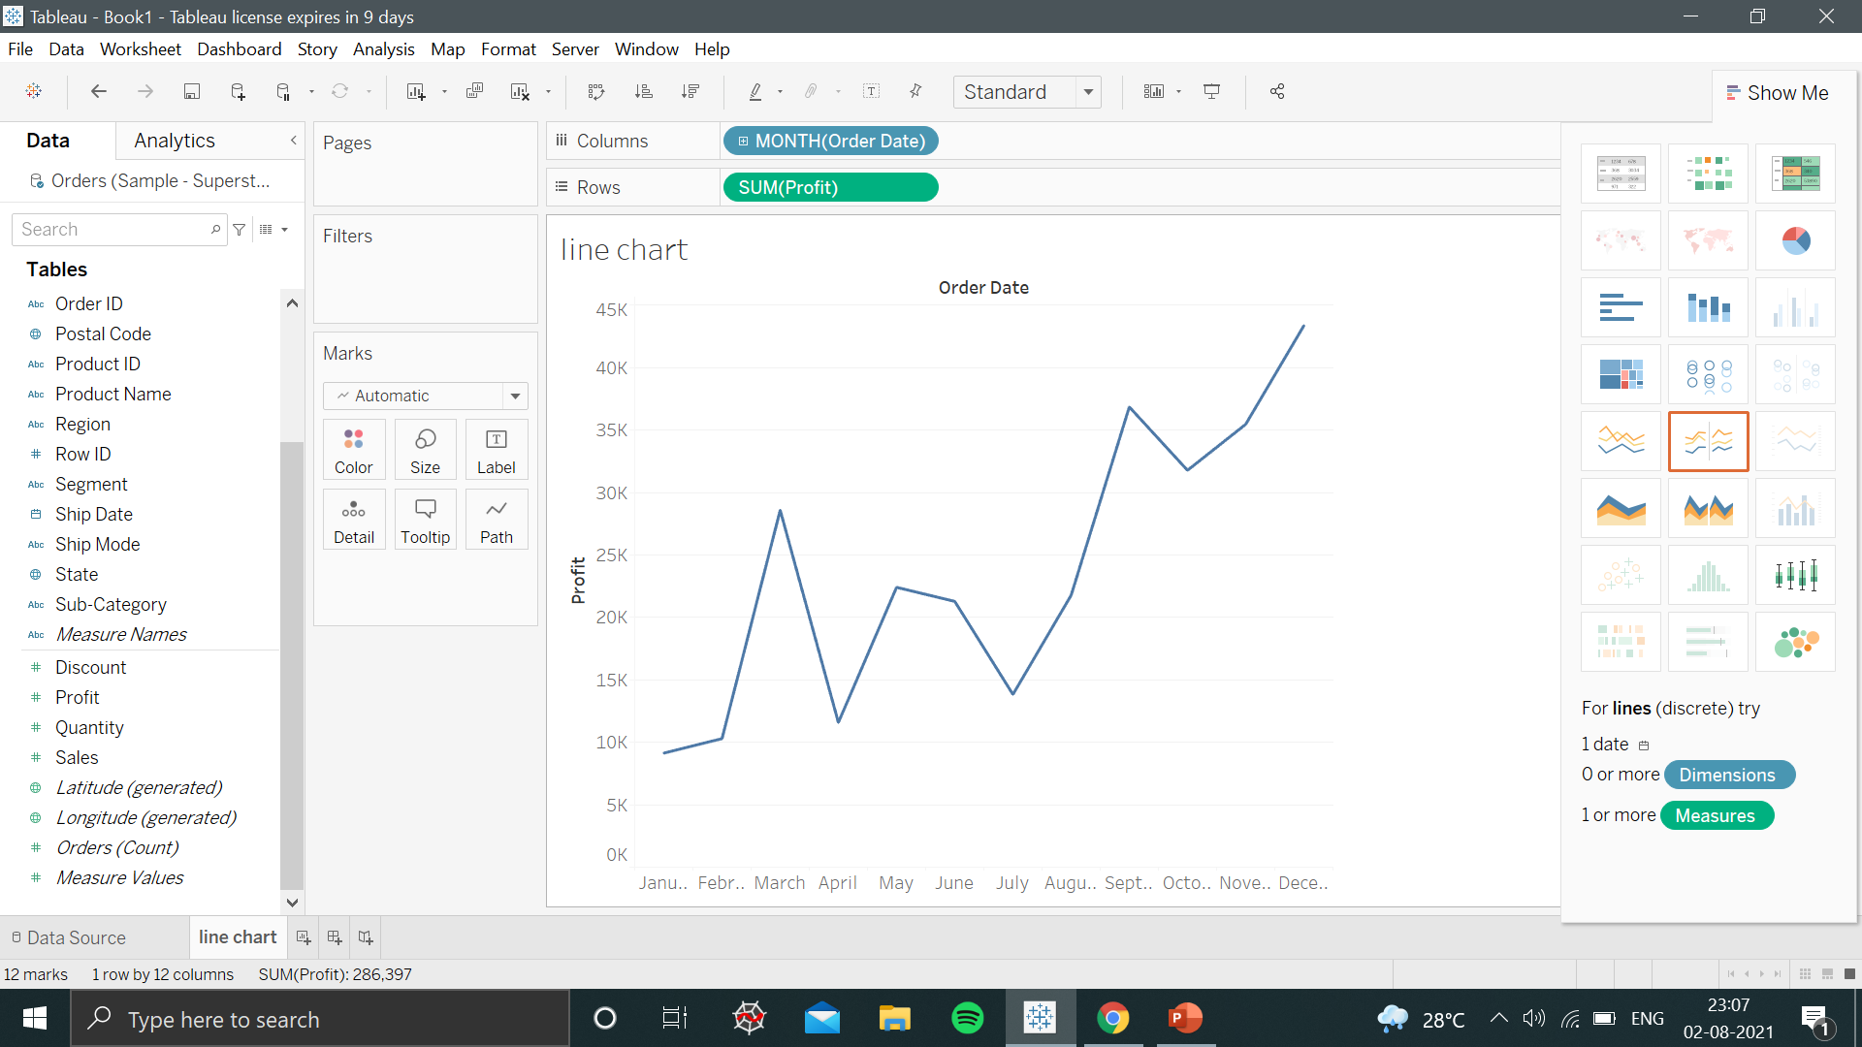
PROFIT BY MONTH

Slide 26
USING FILTERS IN TABLEAU
Filtering is the process of removing certain values or range of values from a result set.
Tableau filtering feature allows to restrict data from a field.
Filtering minimize the size of the data ,removes irrelevant dimension , and makes your data precise for visualization.
For example: You can filter the visualization to display only the top 5 states with heavy rainfall in the month of July , the top five most- coldest state in India, or those states with the highest mortal rate.

Slide 27
TYPES OF FILTERS IN TABLEAU
In Tableau, there are three types of basic filters as follows:
Filters Dimensions: Filter dimensions are the filters applied to the dimension fields.
Filters Measures: Filter measures are the filters applied to the measure fields.
Filter Dates: Filter dates are the filters applied on the date fields.

Slide 28
FILTER DIMENSION
These filters are applied on the dimension fields.
Here , we use the Superstore data source to apply dimension filters on the sub-category of products.
Example:
Drag the dimension field “Sub-Category” to the Rows shelf and the measure field “profit” to the Columns shelf to display profit of each sub-category of products according to their shipping mode.
The result is shown in the next slide.

Slide 29
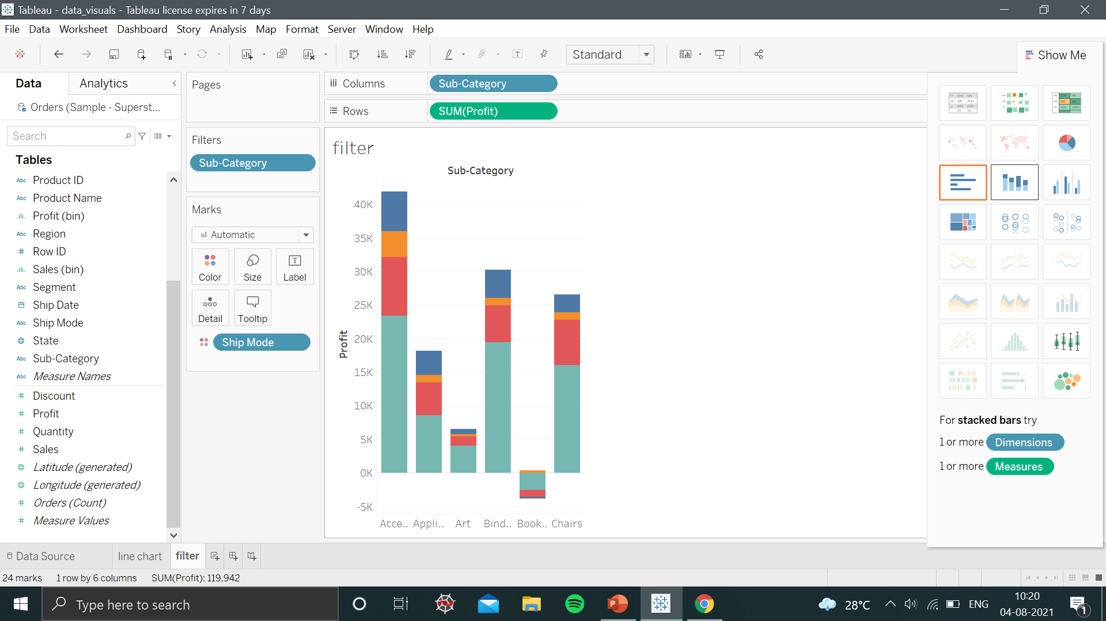
FILTER DIMENSION

Slide 30
FILTER MEASURES
These filters are applied on the measure fields.
In dimension filters you use only values to filter, in measures filter you use calculations based on fields.
Example
Here ,we use the Superstore data source to apply dimension filters on the average value of the profits.
Drag the avg profit in the columns and sub-category in the rows.
To apply filter based on AVG (profit) ,drag the AVG (profit) value to the filter pane , and complete the filteration steps.

Slide 31
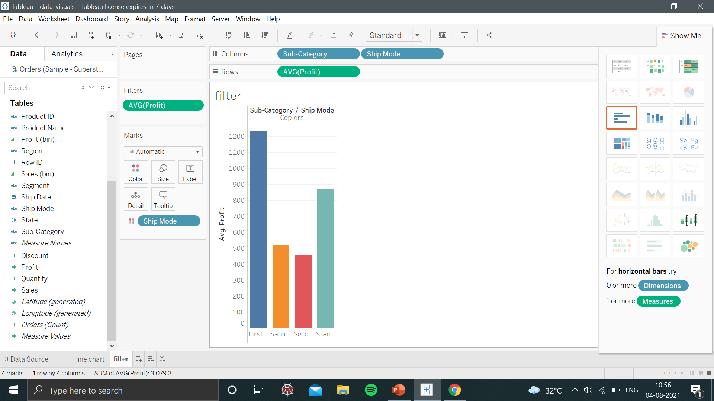
FILTER MEASURES
It shows the subcategories whose average profit is greater than 300.

Slide 32
FILTER DATES
Tableau provide different ways while applying the date field. It can apply filter by taking a relative date ,range of date , starting and ending date etc.
Example:
We choose the sample - Superstore data source and create a view with order date in the column shelf and profit in the rows shelf .
Drag the date “order date” field to the filter shelf and choose the ranges of dates option from the dialog box.
The next slide display the profit made in each month.

Slide 33
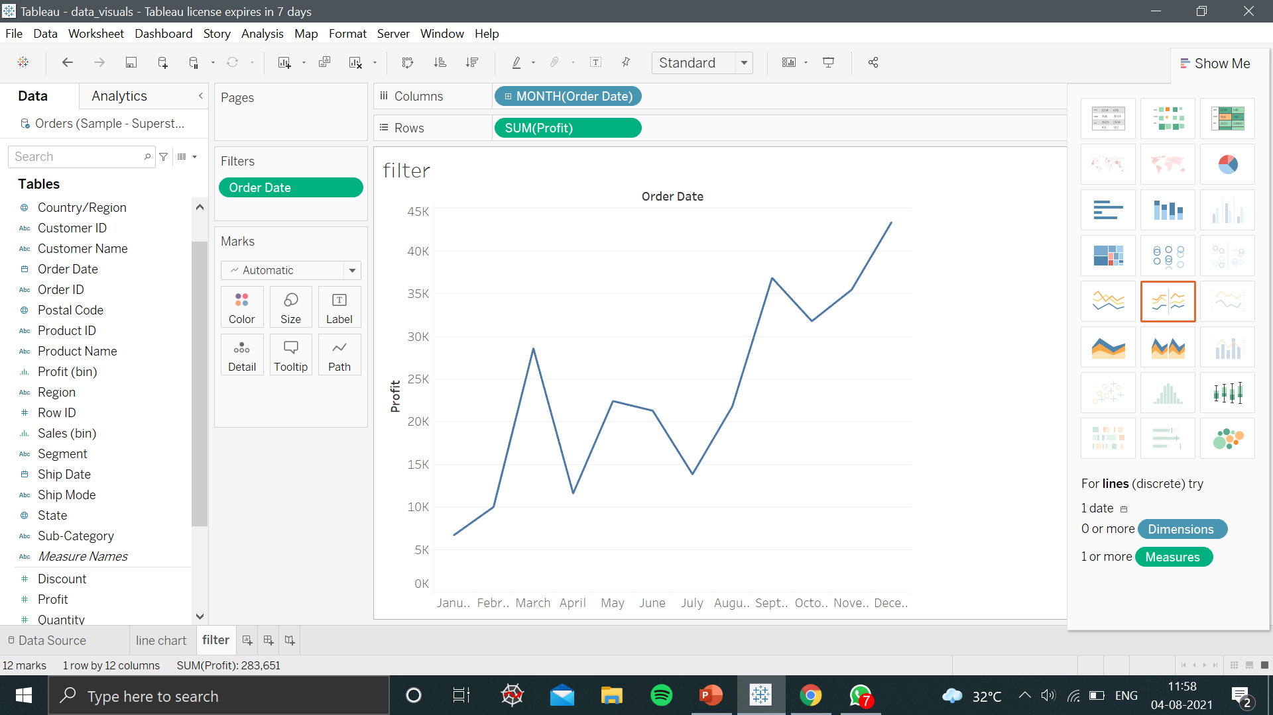
FILTER DATES

Slide 34
CALCULATED FIELDS
Calculated fields helps you to create new data from the existing data source.
When you create a calculated field, you are basically creating a new field (or column) in your data source .
You can create as many calculated field/column according to your requirement’s.
This new calculated field is saved to your data source in Tableau.
However, your original data source remains untouched.

Slide 35
STEPS TO CREATE CALCULATED FIELDS
1. In Tableau, select Analysis > Create Calculated Field.
2. In the Calculation Editor that opens, do the following:
Enter a name for the calculated field
Enter a formula.
When finished, click OK.
3. Now , the new calculated field is added to Measures in the Data pane because it returns a number.
4. An equal sign (=) appears next to the data type icon of all calculated fields.

Slide 36
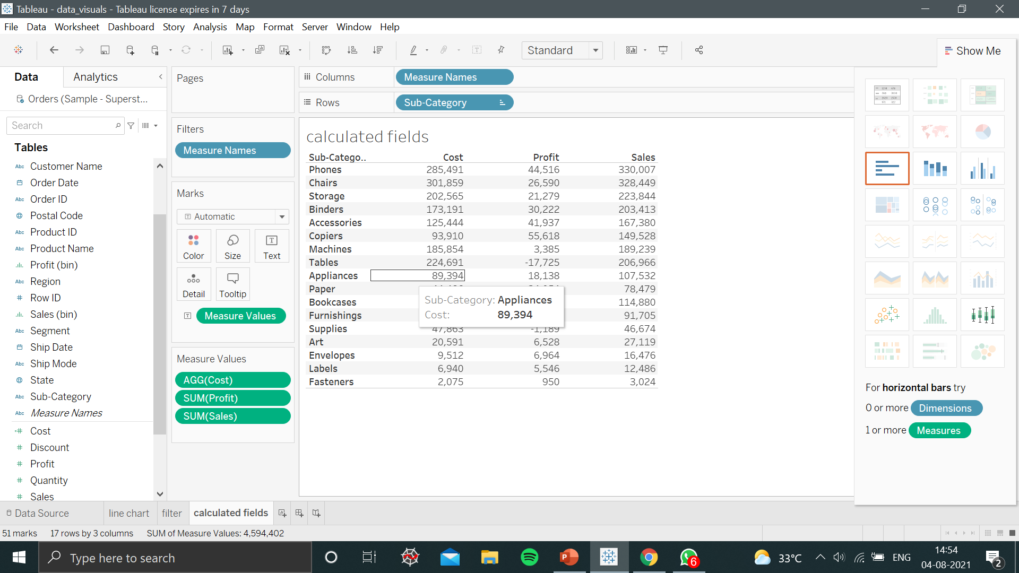
CREATING CALCULATED FIELD (COST)

Slide 37
PARAMETERS IN TABLEAU
A Parameter is any value passed to a program in order to customize the program for a particular purpose.
A parameter can be a string, a range of values ,numbers etc.
We can use parameters dynamically to enter values that are not present in our data set.
After creation, end users can control the input according to their requirement’s for visualization.

Slide 38
STEPS TO CREATE A PARAMETER IN TABLEAU
These steps use the Superstore sample to create new parameters.
In the Data pane, click the drop-down arrow in the upper right corner and select Create Parameter.
A dialog box with a create parameter will appear on your screen.
Name the parameter .
Select the data type’s.
Customize the dialog box as per your preference.
Then , click “ok” to exit.

Slide 39
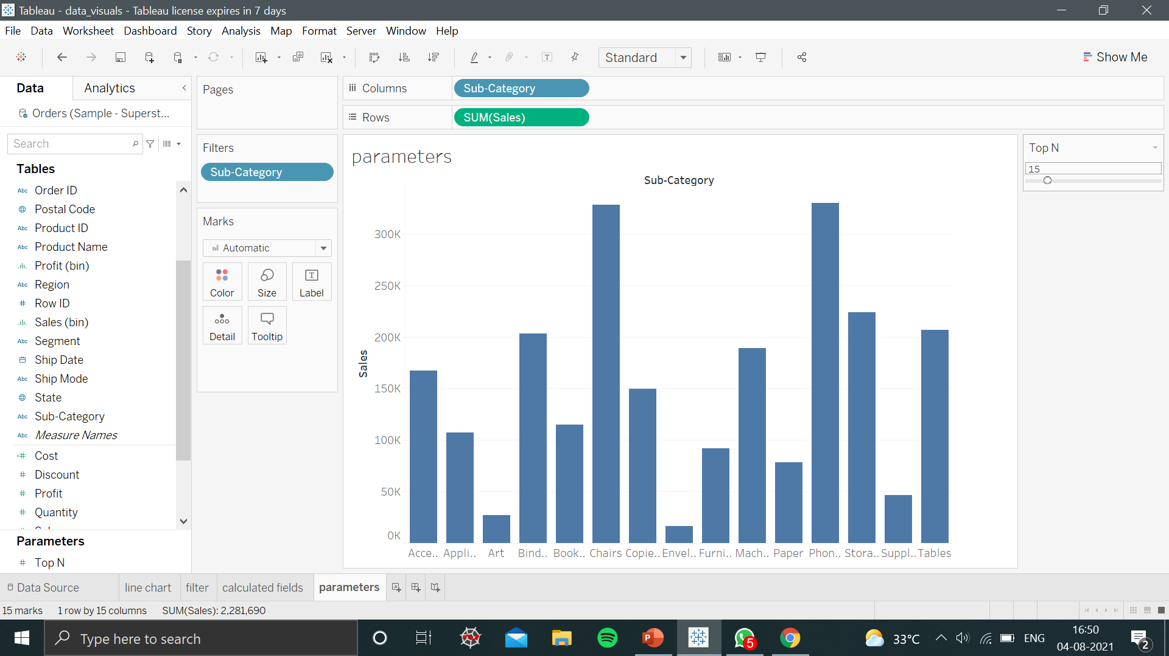
CREATING PARAMETER’S (Top N)

Slide 40
CREATING TABLES IN TABLEAU
To create table in Tableau follow the steps given below:
Connect to the Sample - Superstore data source.
Drag the Measure Names dimension to Columns to create column headers.
3. Drag the Sub-Category dimension to Rows to create row headers.
4. Tableau Columns with headers plus rows with headers means that a valid table structure now exists.
5. Now you can add a measure Names to filter shelf to apply filter.
6. Drag the Measure Values to Text on the Marks card.
7. Tableau aggregates the measure and display the final result.

Slide 41

TABLE IN TABLEAU

Slide 42
TYPES OF CHARTS
Bubble Chart
In the bubble chart, the data is displayed with the help of circles.
This type of chart helps in depicting the relationship between three or more measures.
Bubble charts can visualise large volumes of data at once by varying the colour and size of the circles.

Slide 43
STEPS TO CREATE BUBBLE CHART
Connect to the Sample - Superstore data source.
Drag the Category dimension to Columns.
Drag the Sales measure to Rows.
The measure is aggregated as a sum.
Tableau displays a bar chart by default when there is a dimension on the Columns shelf and a measure on the Rows shelf.
6.Click Show Me on the toolbar, then select bubbles chart.

Slide 44
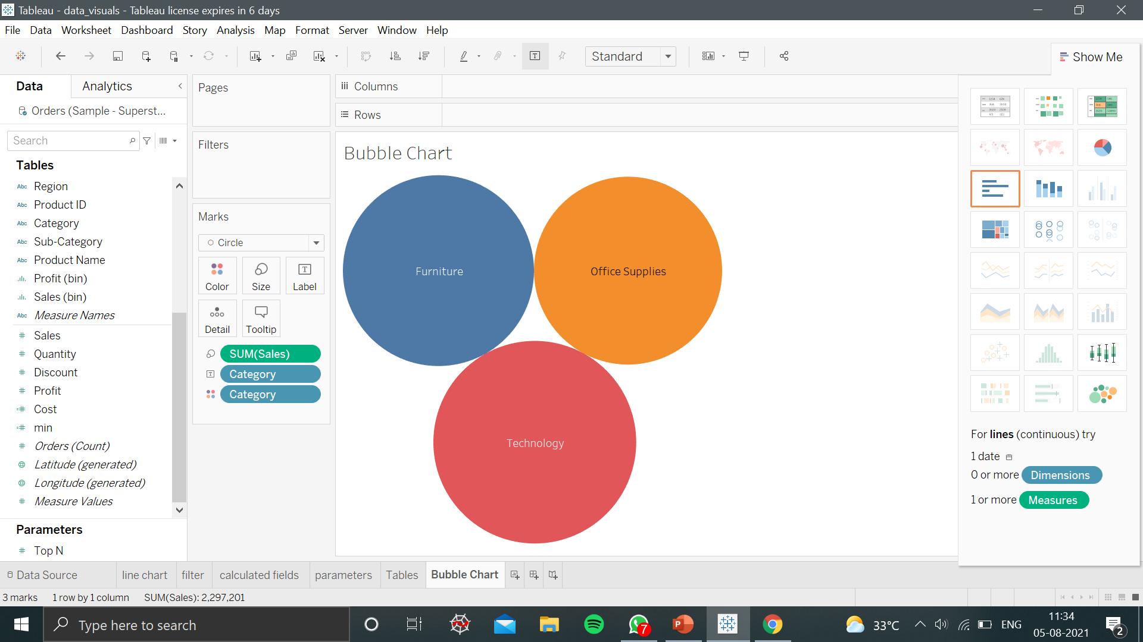
BUBBLE CHART REPRESENTATION

Slide 45
STEPS TO CREATE HISTOGRAM
A histogram is a chart that displays the shape of a distribution.
Steps to create histogram in Tableau.
Connect to the Sample - Superstore data source.
Drag Quantity to rows shelf.
Drag category to column shelf.
Click Show Me on the toolbar, then select the histogram chart type.
Drag the Region dimension in the color shelf under Marks to display a stack histogram.

Slide 46
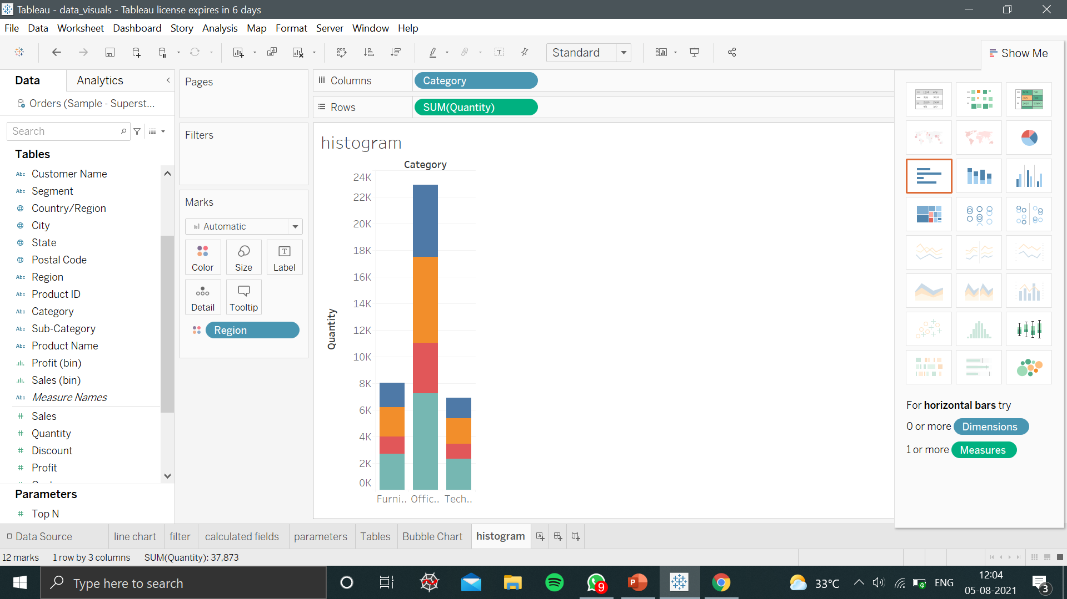
HISTOGRAM REPRESENTATION

Slide 47
SCATTER PLOT
Steps to create Scatter Plot:
Here, let’s find the variation of sales and profit.
Step 1 − Drag and drop the measure Sales to the Columns shelf.
Step 2 − Drag and drop the measure Profit to the Rows shelf.
Step 3 − Pull the dimension Sub-Category to the labels Shelf under Marks.

Slide 48
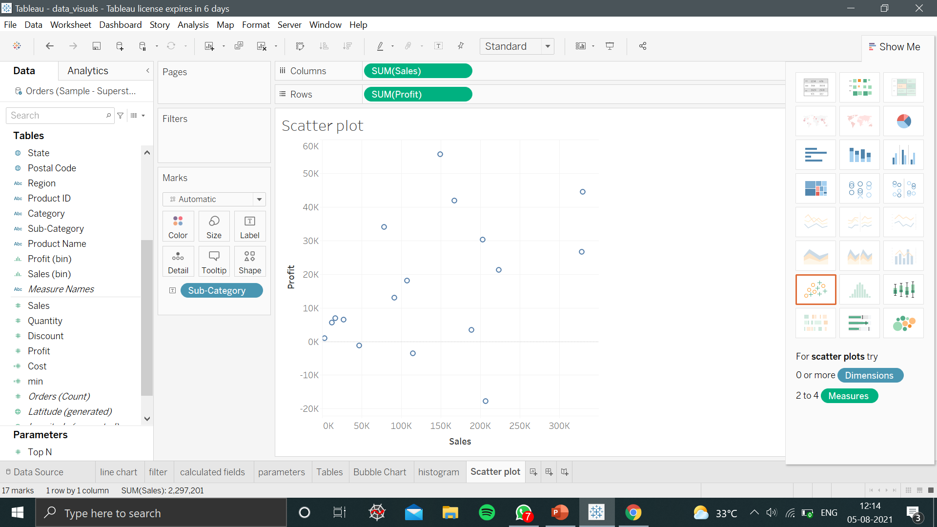
SCATTER PLOT REPRESENTATION

Slide 49
BOX PLOT
Boxes indicate the middle 50 percent of the data .
Follow these steps to create a box plot that shows discounts by region and customer segment :
1. Connect to the Sample - Superstore data source.
Drag the Segment dimension to Columns.
Drag the Discount measure to Rows.
Drag the Region dimension to Columns, and drop it to the right of Segment.
5. Click Show Me in the toolbar, then select the box-and-whisker plot chart type.

Slide 50
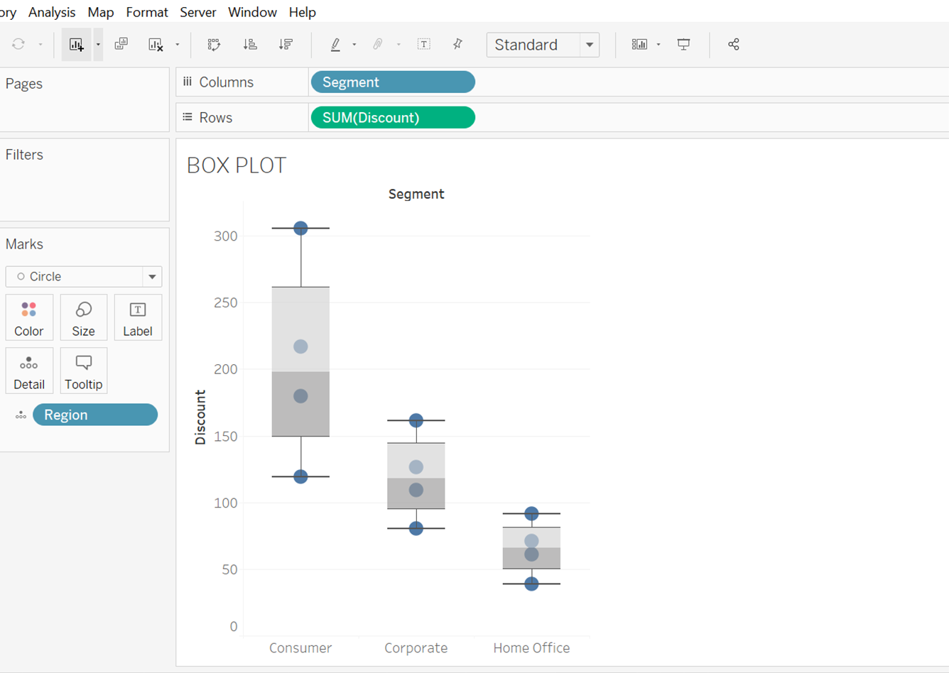
BOX PLOT REPRESENTATION

Slide 51
SIMPLE PIE CHART
Choose one dimension and one measure to create a simple pie chart.
Follow the steps to create a pie chart in Tableau:
1. Drag the dimension named region and drop it in the colors and label marks. .
2. Drag the measure named profit and drop it in the size mark and angle mark.
3. Click Show Me in the toolbar, then select pie-chart type.

Slide 52
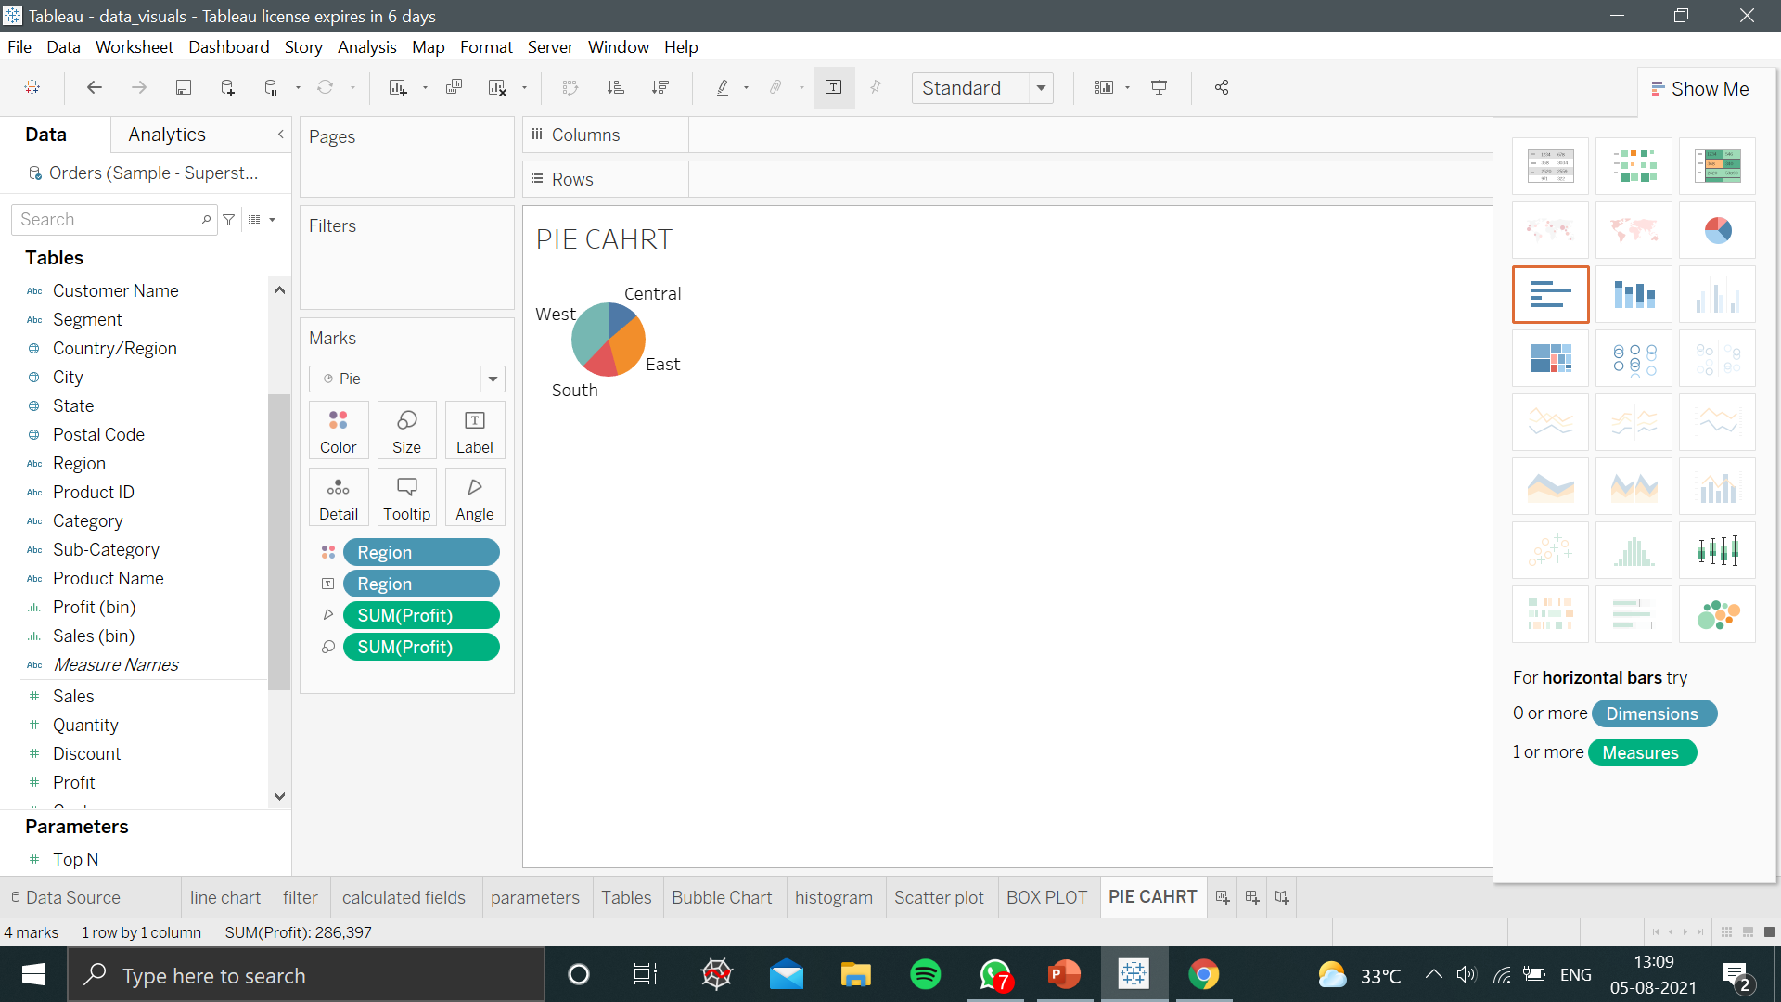
PIE CHART REPRESENTATION

Slide 53
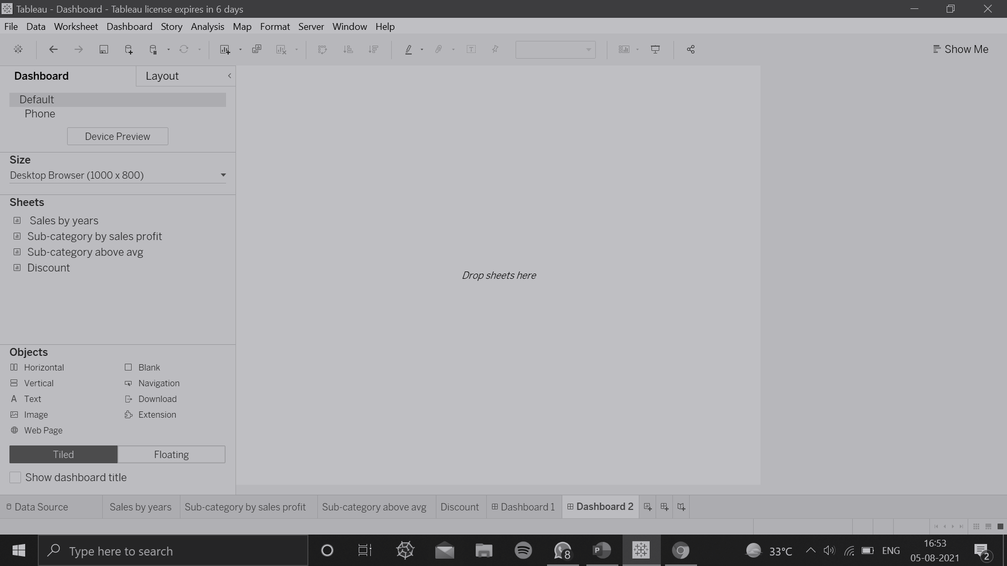
CREATE A DASHBOARD
Creating a dashboard in Tableau is much easier as you create your new worksheet.
Steps to follow to create a dashboard:
At the bottom of the workbook, click the New Dashboard icon:
ii. Create multiple worksheets and drag it in the Dashboard.

Slide 54
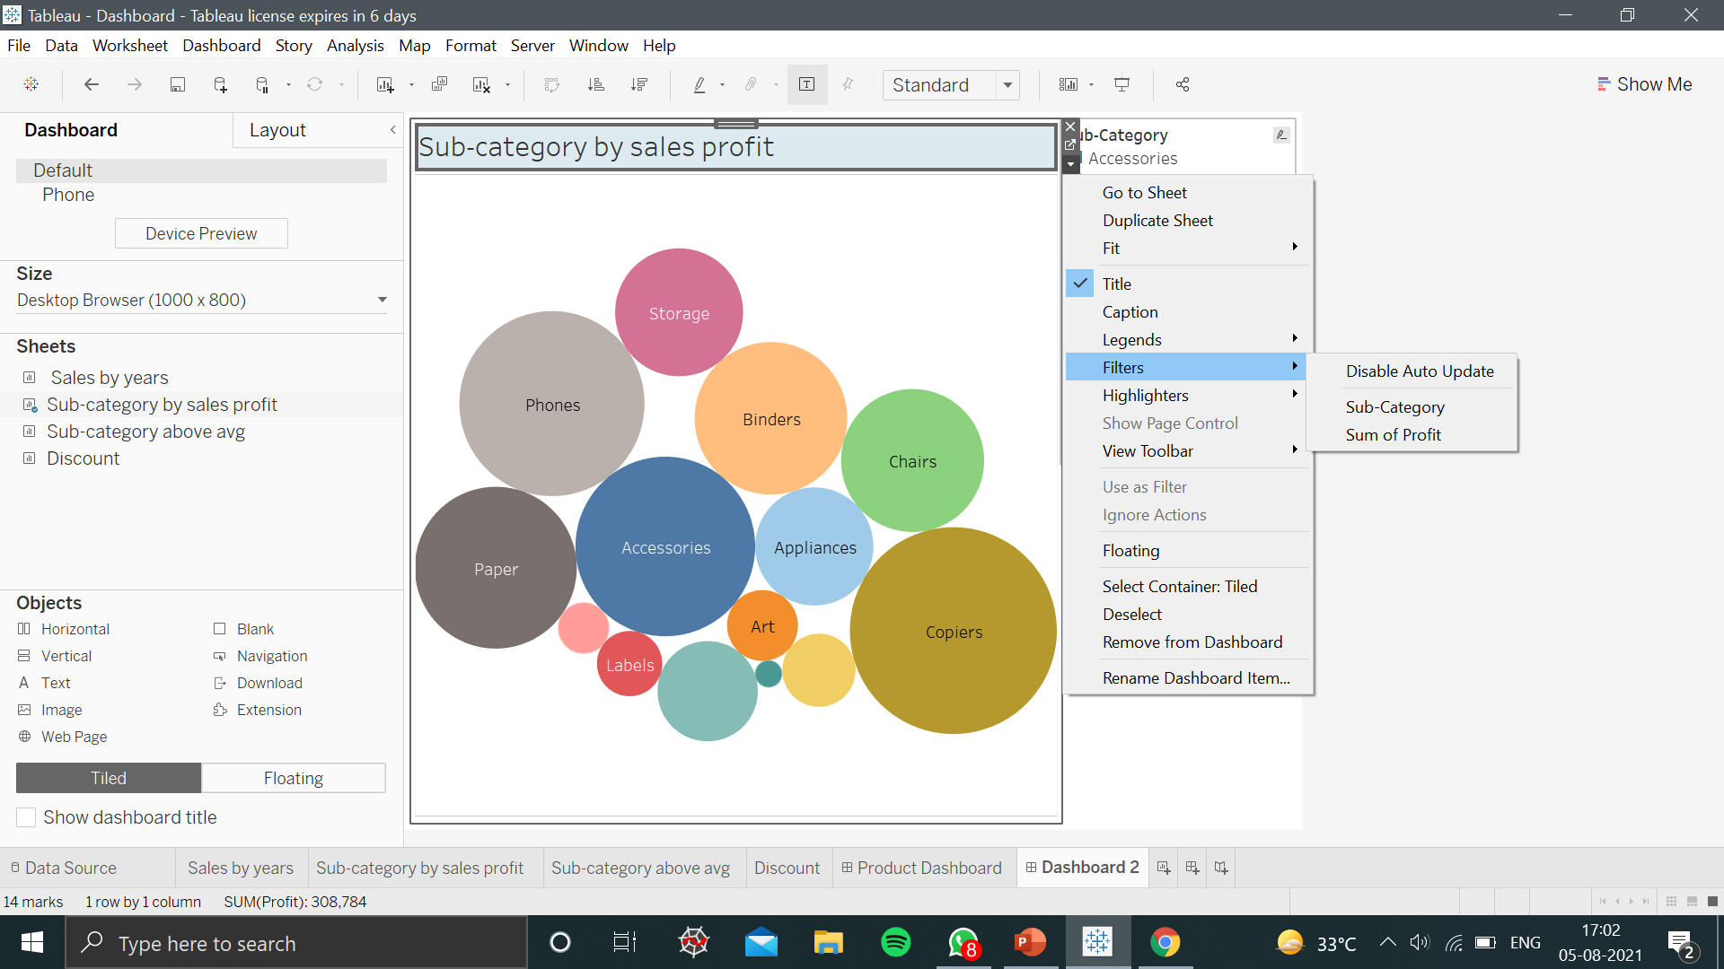
ADD FILTERS AND ACTIONS
You can add interactivity such as filters and add some actions to dashboards to enhance users’ interaction with the data.
In the upper corner of sheet, click on the drop down arrow option to edit and add filters on the sheets in the dashboard.

Slide 55
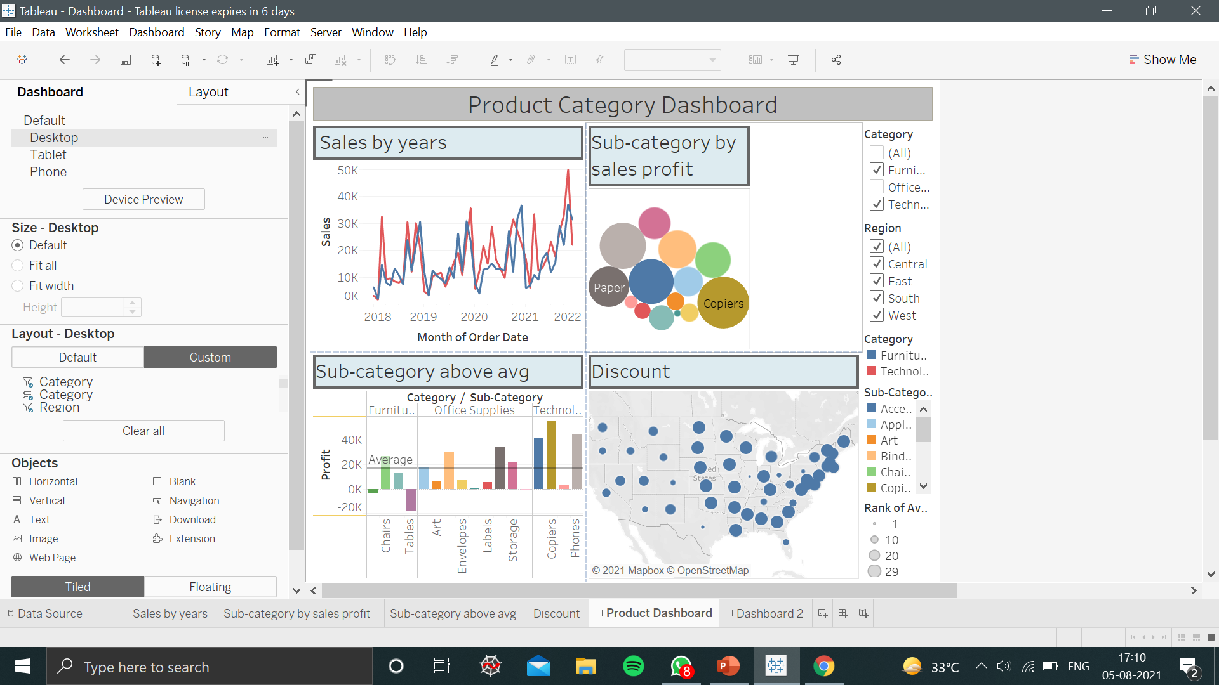
DASHBOARD REPRESENTATION WITH MULTIPLE WORKSHEET’S

Slide 56
STORY BOARD IN TABLEAU
A story is also a collection of sheets, arranged in a sequence for visualisations.
Each individual sheet in a story is called a story point.
Steps to create a story Board:
Click the New Story tab.
You will be presented with a blank workspace that displays, "Drag a sheet here."
This is where you'll create your first story point.

Slide 57
STEPS TO CREATE STORY BOARD
1. From the Story pane on the left, drag the worksheet on the right side.
2. Add a caption so that viewer’s can see and understand for example, “Sales by years.“
3. To add more worksheet onto your story board click on the blank option present in the left side of the story pane.
4. Repeat the process of adding unless you finished adding all your worksheet’s.

Slide 58
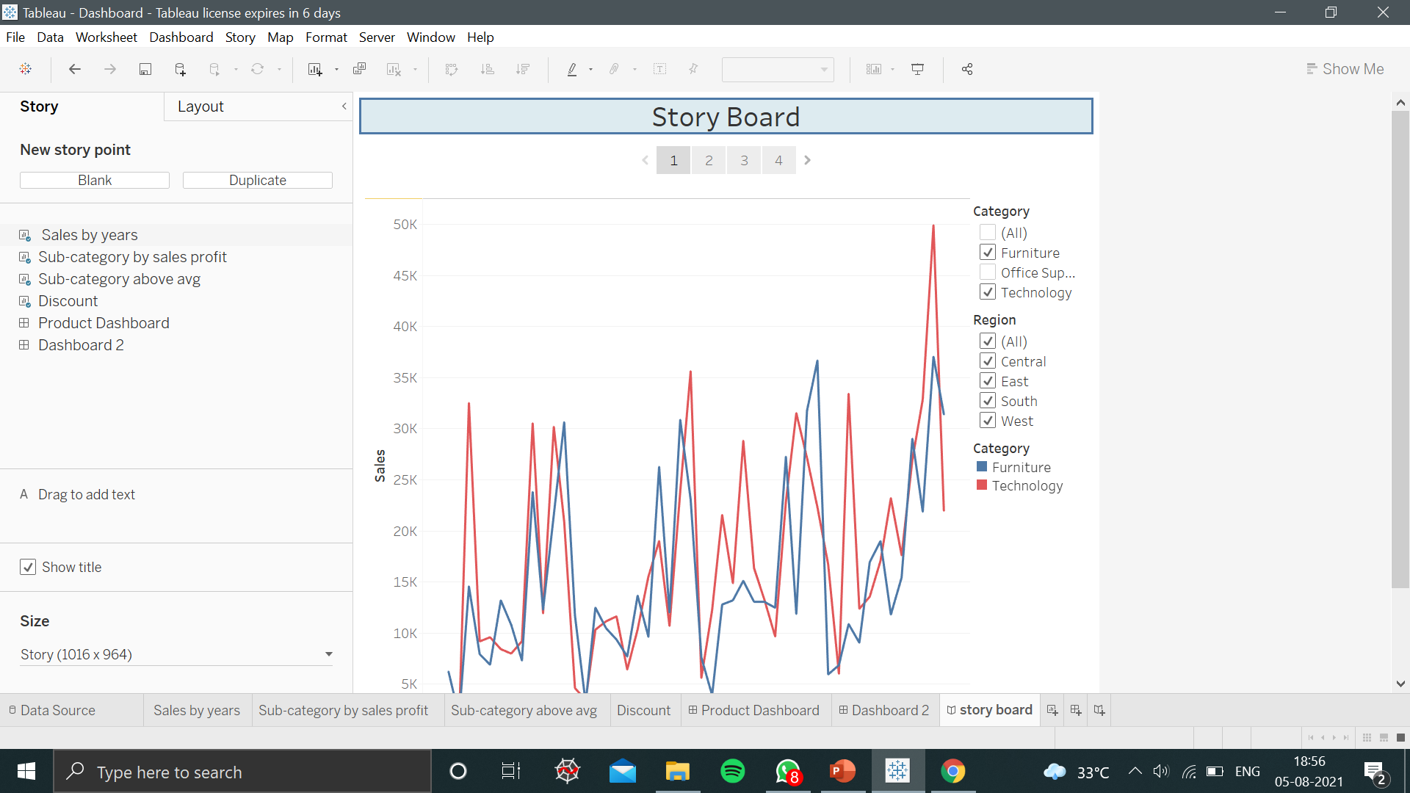
REPRESENTATION OF STORY BOARD

Slide 59
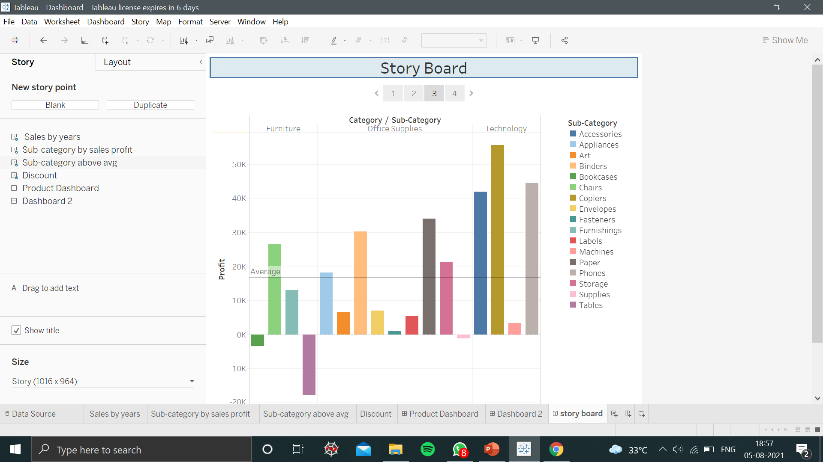
REPRESENTATION OF STORY BOARD
Notes:
Url link : https://www.1377x.to/torrent/5351911/Tableau-Masterclass-Advanced-Training-in-Tableau-Desktop/

Slide 60

Thank You !!!
(USA)
2-Industrial Park Drive, E-Waldorf, MD, 20602,
United States
(USA)
+1-844-889-4054
(Singapore)
3 Temasek Avenue, Singapore 039190
info@careerera.com www.careerera.com
(INDIA)
B-44, Sector-59, Noida Uttar Pradesh 201301
(INDIA)
+91-92-5000-4000

